Slide 1
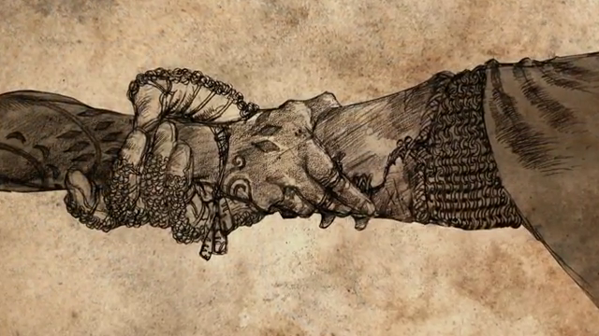
Consumer driven contract testing
With Pact

Slide 2
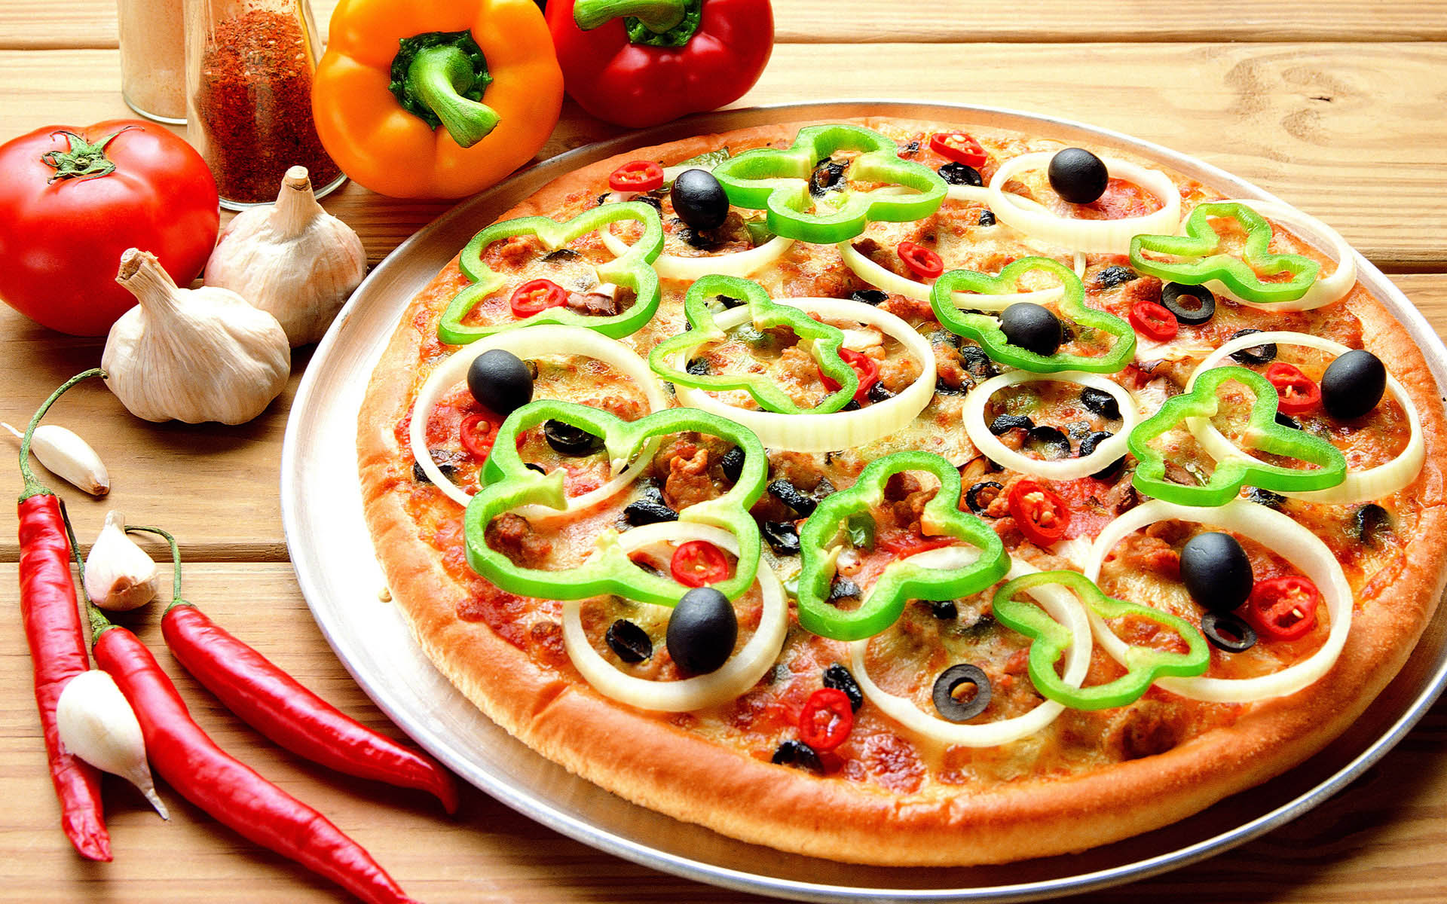

Slide 3





Ordina
Costs
Size

Slide 4
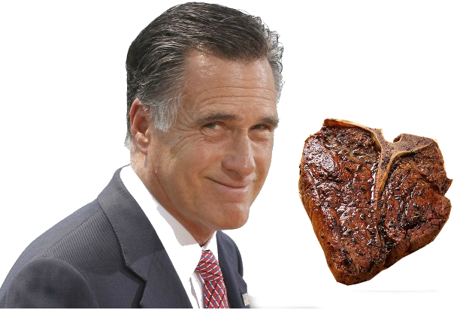
Meat Romney
Meat
A lot of it

Slide 5
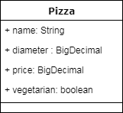



Queenslizepizza

Slide 6
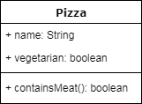
Integration Test
Given that there are pizzas When I get the menu
Then I can see which ones have meat in them
So I can order the meatiest one
Queenslizepizza

Slide 7
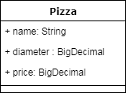
Integration Test
Given that there are pizzas When I get the menu
Then we can see the price and diameter of them
So we can use these numbers in the BU meeting
Queenslizepizza

Slide 8


Slide 9







Slide 10


Slide 11






Slide 12


Ann Hannah
New client
Pineapple
➔To the backlog !

Slide 13
€ != $

Slide 14


Slide 16




Slide 17


Slide 19
Consumer driven contract testing
Layer of comfort
Usage, how, which endpoints, ...
Great for µServices
Pacts are usually small
Lots of back and forth internally
Best if communication lines are short

Slide 20


Multilanguage support
Java
Javascript
Ruby
Go
....
Readable contract
JSON
Nice features
Broker
Documentation

Slide 21
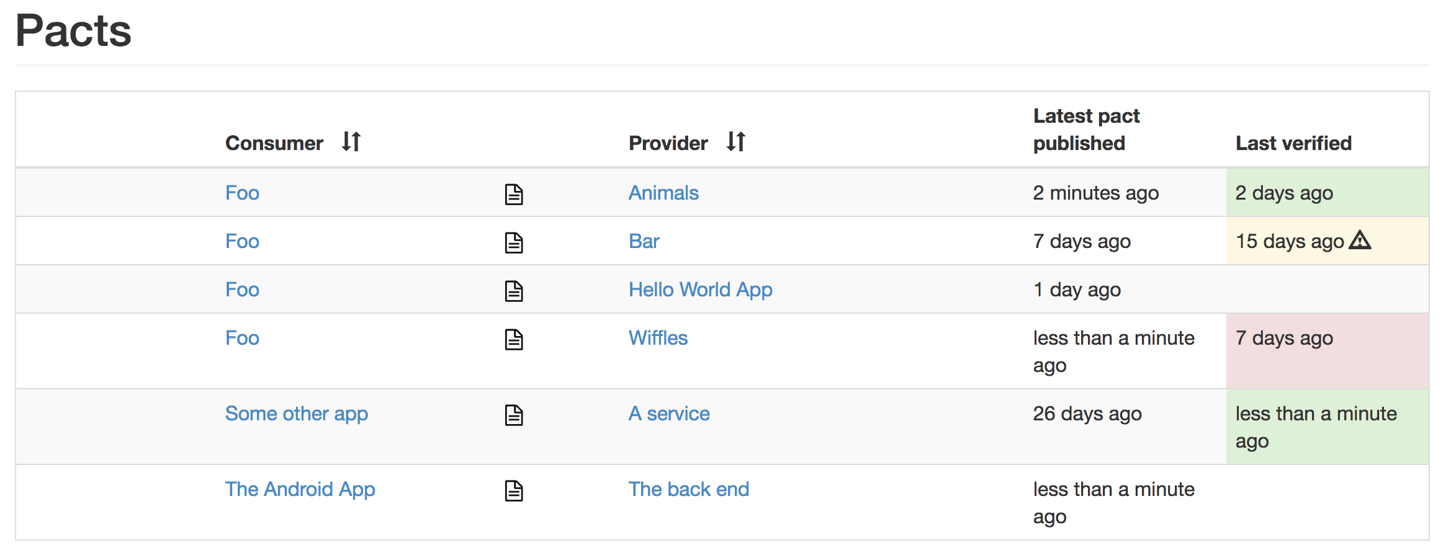

Slide 22

Interested?
pact.io & docs.pact.io
Demo @ /Hpacquee/lightning-pact
Have questions or want to see it in action?
Stay a little, have a drink
Come have a talk

